Slide 1

Tensor Flow

Slide 2
Top Deep learning libraries
Torch: deep learning framework developed by Ronan Collobert, Clement Farabet and Koray Kavukcuoglu for research and development into deep learning algorithms. It is used and promoted by the CILVR Lab at NYU (home to Yann LeCun). Torch is used and has been further developed by the Facebook AI lab
http://torch.ch/
The Microsoft Cognitive Toolkit (CNTK): a unified deep-learning toolkit
https://github.com/Microsoft/CNTK/wiki
TensorFlow
https://www.tensorflow.org/
Keras (a wrapper around TensorFlow)
Caffee: Caffe is a Python deep learning library developed by Yangqing Jia at the Berkeley Vision and Learning Center for supervised computer vision problems.
http://caffe.berkeleyvision.org
DeepLearning4J (DL4J): a Deep Learning framework developed in Java (and JVM languages) by Adam Gibson for commercial deep learning projects
https://deeplearning4j.org/
Darch: Deep learning in R
http://cran.um.ac.ir/web/packages/darch/index.html
Theano: Theano is a Python framework developed by the LISA group (now MILA) run by Yoshua Bengio at the University of Montreal for research and development into state of the art deep learning algorithms (development discontinued)
https://github.com/Theano/Theano

Slide 3
What is TensorFlow?
Open source software library for numerical computation using data flow graphs
Developed by Google brain team to conduct machine learning research
Provides an extensive suite of functions and classes that allow users to build various models from scratch
TensorFlow is an interface for expressing machine learning algorithms, and an implementation for executing such algorithms

Slide 4
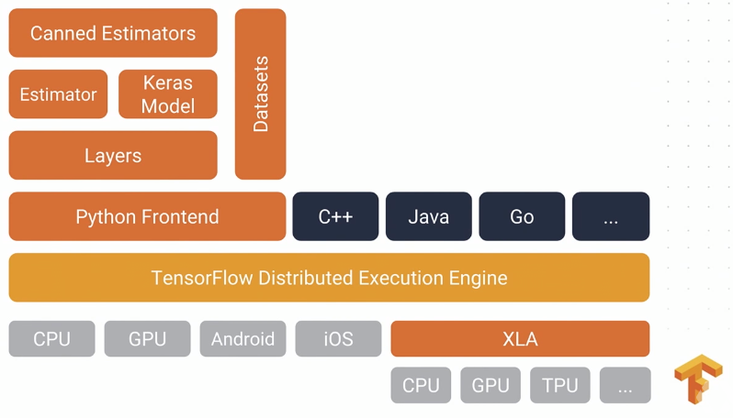
TensorFlow architecture

Slide 5
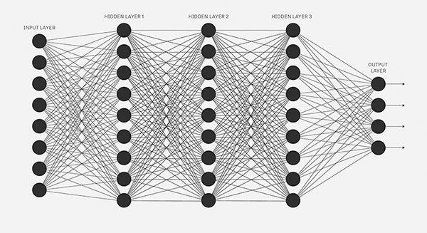
Why TensorFlow?
Python API
Portability: deploy computation to one or more CPUs or GPU in a desktop, server, or mobile device with a single API
Visualization (TensorBoard)
Checkpoints (for managing training)
Automatic computation of the gradient
Scales very well to distributed computing clusters
Large community
Awesome projects already using TensorFlow
Success in industry adoption: Google, OpenAI, DeepMind, Uber, Snapchat, Airbus, eBay, Dropbox, Many others…

Slide 6
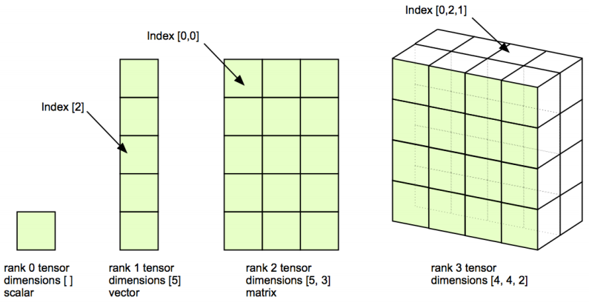
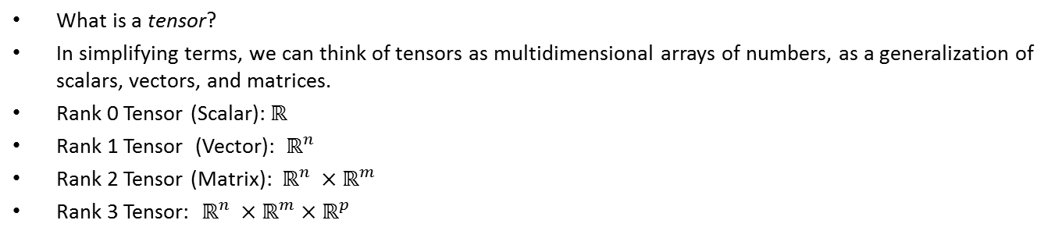
A word about tensors
What is a tensor?
In simplifying terms, we can think of tensors as multidimensional arrays of numbers, as a generalization of scalars, vectors, and matrices.
Rank 0 Tensor (Scalar): $ℝ$
Rank 1 Tensor (Vector): $ℝ^{n}$
Rank 2 Tensor (Matrix): $ℝ^{n} ×ℝ^{m}$
Rank 3 Tensor: $ℝ^{n} ×ℝ^{m}×ℝ^{p}$

Slide 7
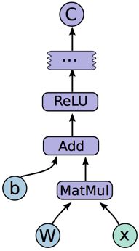
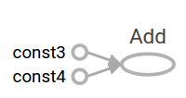
Tensor flow graphs
You might think of TensorFlow Core programs as consisting of two discrete sections:
Building the computational graph.
Running the computational graph.
A computational graph is a series of TensorFlow operations arranged into a graph of nodes.
const3= tf.constant(3.0, tf.float32)
const4 = tf.constant(4.0)
result = tf.add(const3, const4)

Slide 8
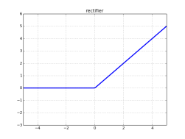



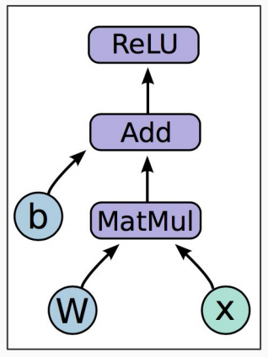
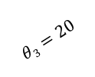

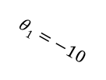
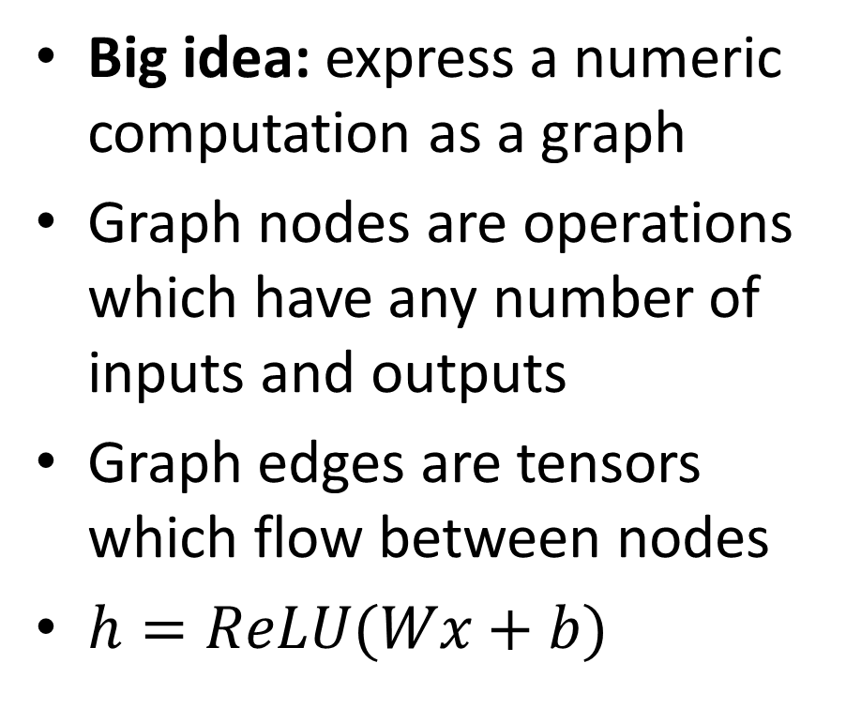


Programming model
ReLU
$$θ1=−10$$
$$θ2=20$$
$$f(z)$$
$$z$$
$$θ3=20$$
Big idea: express a numeric computation as a graph
Graph nodes are operations which have any number of inputs and outputs
Graph edges are tensors which flow between nodes
$h=ReLU(Wx+b)$

Slide 9
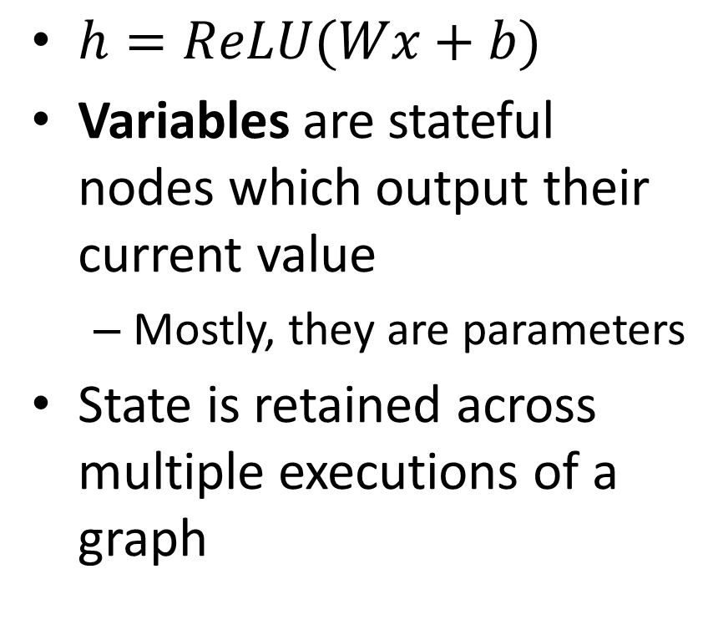
Variables
$h=ReLU(Wx+b)$
Variables are stateful nodes which output their current value
Mostly, they are parameters
State is retained across multiple executions of a graph

Slide 10
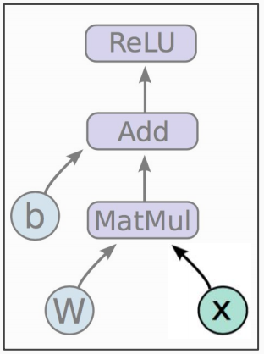
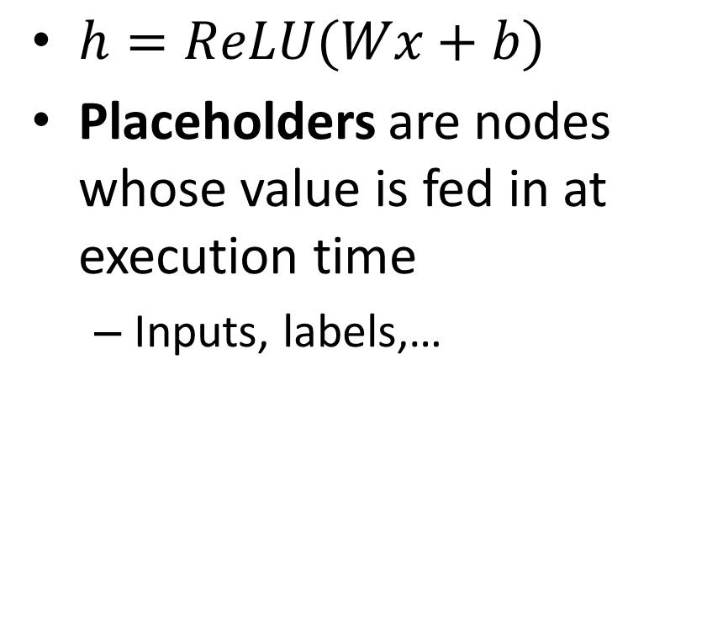
Placeholders
$h=ReLU(Wx+b)$
Placeholders are nodes whose value is fed in at execution time
Inputs, labels,…

Slide 11
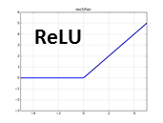
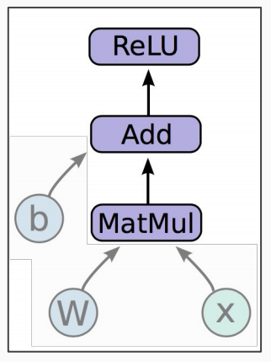
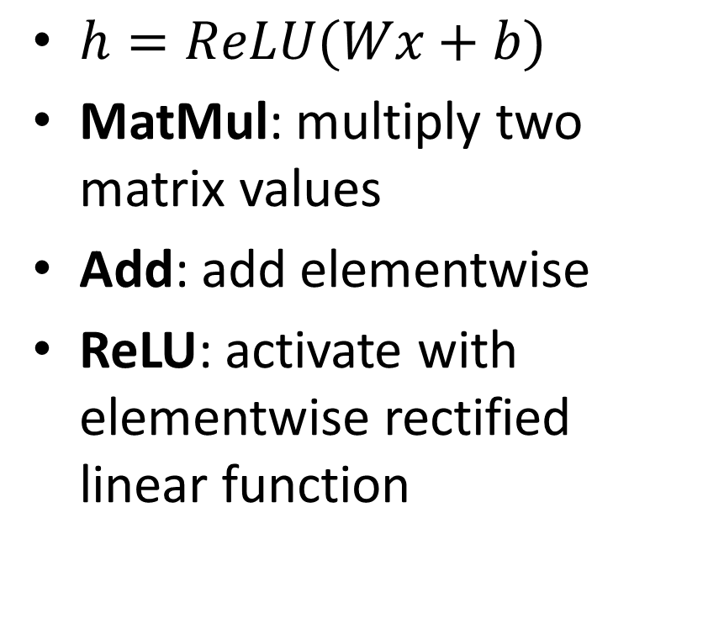
Mathematical operations
$h=ReLU(Wx+b)$
MatMul: multiply two matrix values
Add: add elementwise
ReLU: activate with elementwise rectified linear function

Slide 12
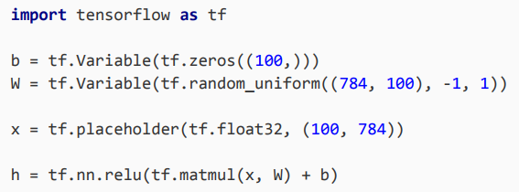
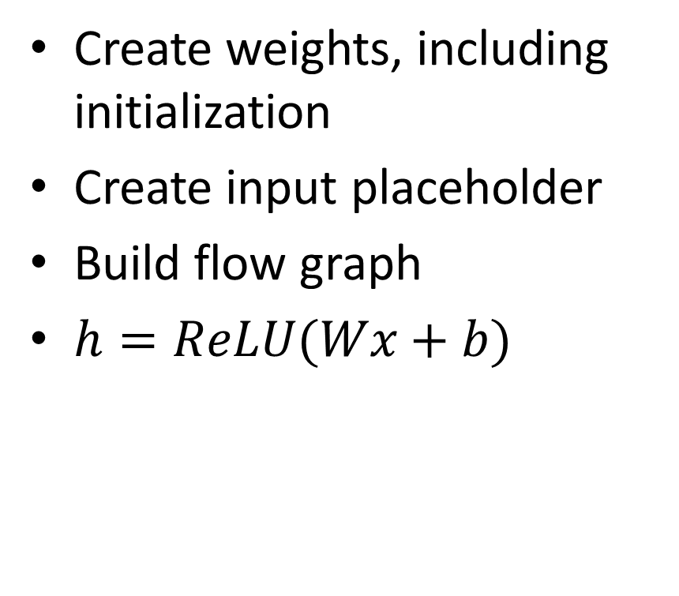
In code
Create weights, including initialization
Create input placeholder
Build flow graph
$h=ReLU(Wx+b)$

Slide 13
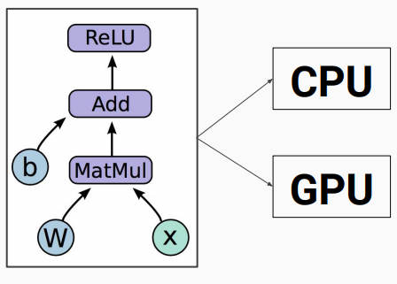
How do we run it?
So far we have defined a graph
We can deploy this graph with a session: a binding to a particular execution context (e.g. CPU, GPU,TPU…)
Vectorized computation

Slide 14
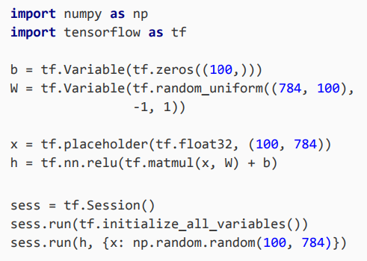
How do we run it?
sess.run(fetches, feeds)
Fetches: List of graph nodes. Return the outputs of these nodes
Feeds: Dictionary mapping from graph nodes to concrete values. Specifies the value of each graph node given in the dictionary.

Slide 15
What have we covered so far?
We first built a graph using variables and placeholders
We then deployed the graph onto a session, which is the execution environment
Next we will see how to train the model

Slide 16
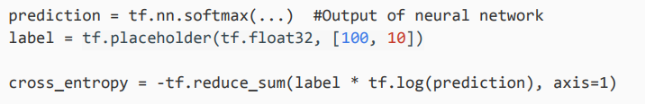
How do we define the loss?
Use placeholder for labels
Build loss node using labels and prediction

Slide 17
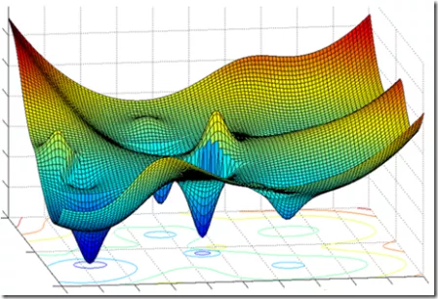
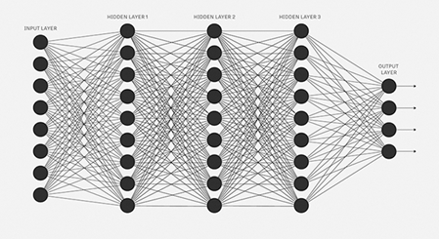
How do we compute gradients?
TensorFlow graph nodes have attached gradient operations
Gradient with respect to parameters computed with backpropagation automatically
train_step = tf.train.GradientDescentOptimizer(0.5).minimize(cross_entropy)

Slide 18
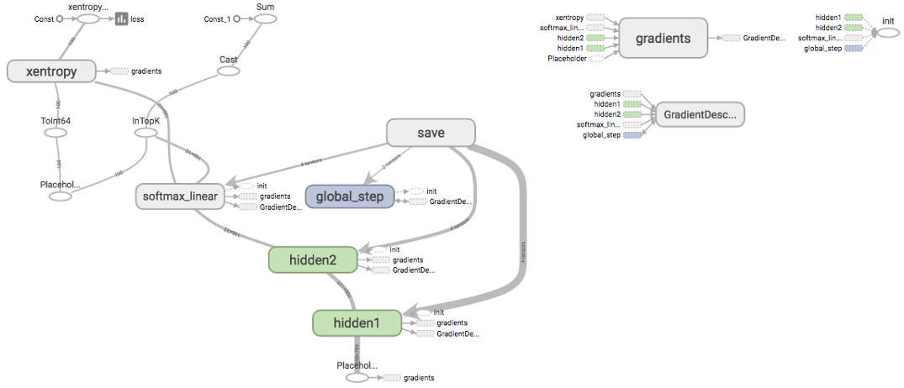
Tensor flow graphs for real problems are convoluted

Slide 19
TensorBoard
The computations you'll use TensorFlow for - like training a massive deep neural network - can be complex and confusing.
To make it easier to understand, debug, and optimize TensorFlow programs, TensorBoard offers a suite of visualization
You can use TensorBoard to visualize your TensorFlow graph, plot quantitative metrics about the execution of your graph, and show additional data like images that pass through it.
tensorBoard operates by reading TensorFlow event files, which contain summary data that you can generate when running TensorFlow

Slide 20
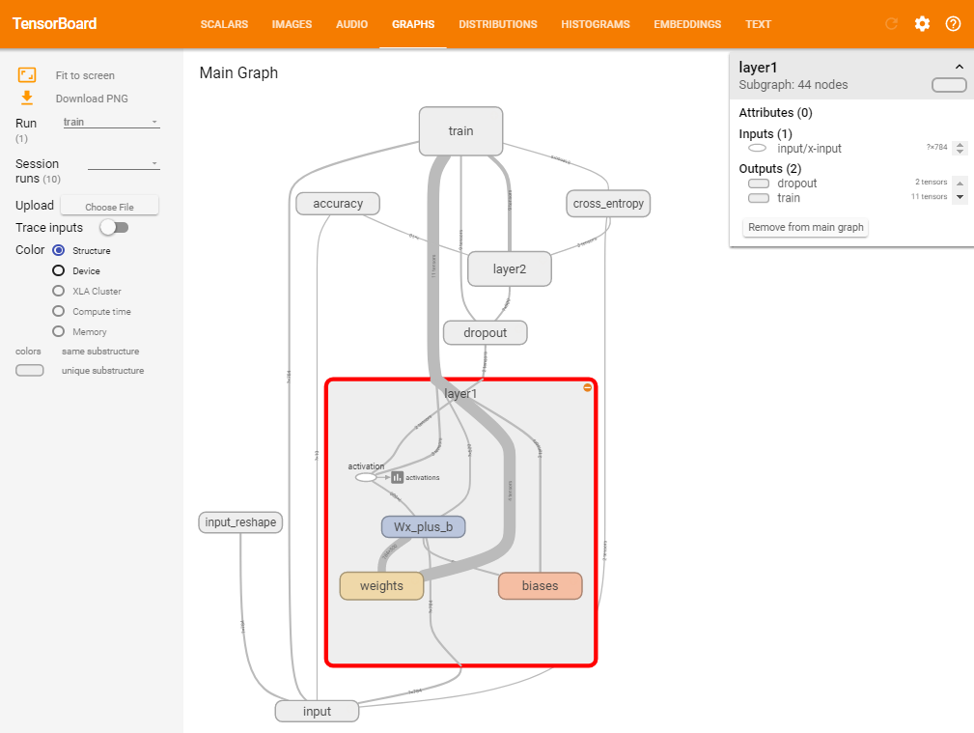
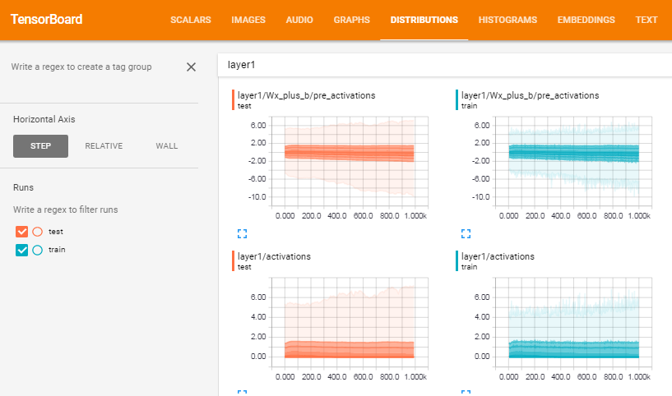

Slide 21
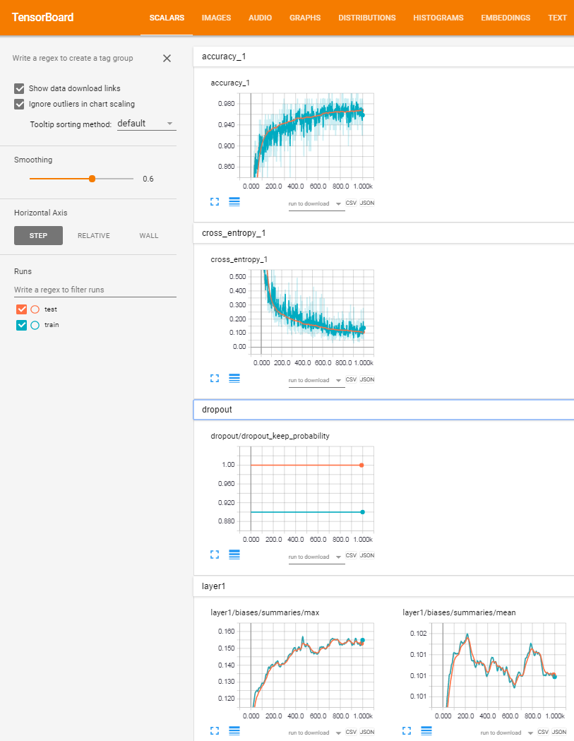
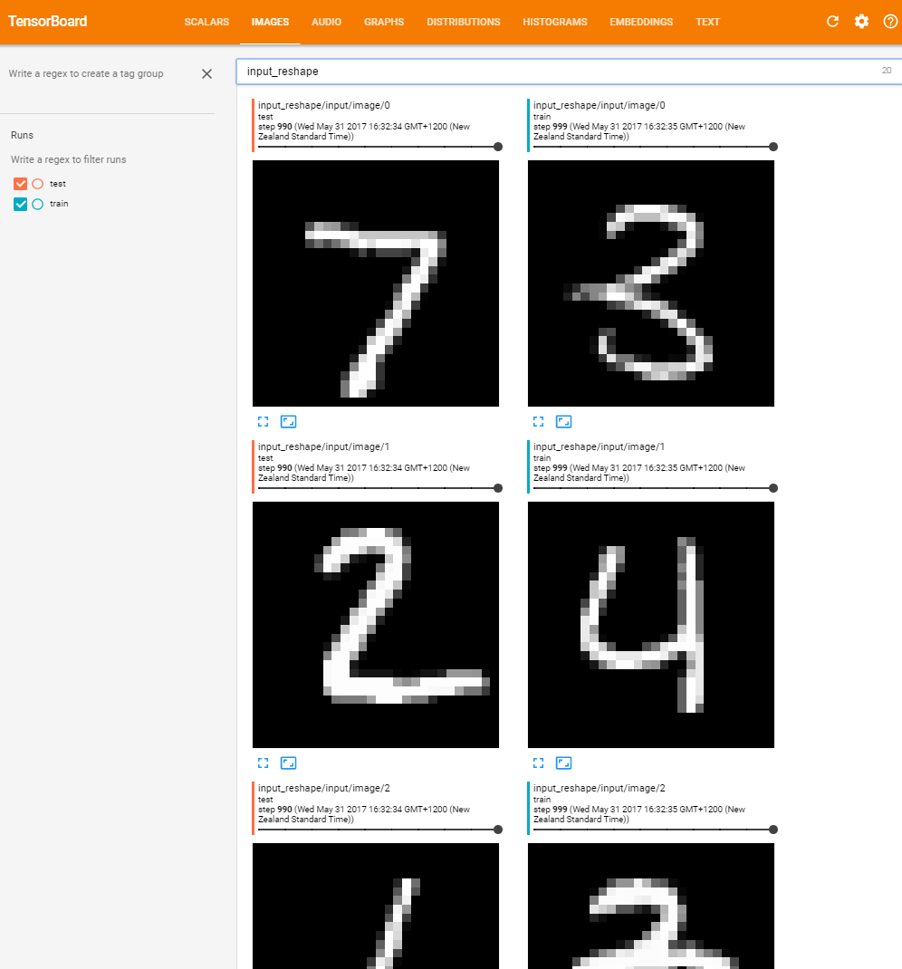

Slide 22
